Slide 1
Static keyword
static int instances = 0;

Slide 2
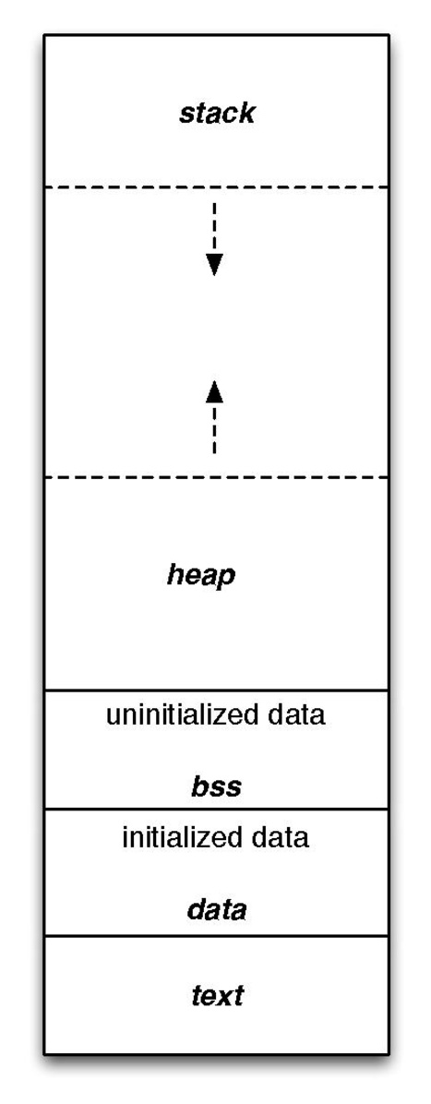
What is a static Variable?
https://en.wikipedia.org/wiki/.bss
A static variable is one that is in memory from program launch to tear down (the program’s lifetime)
It is stored in the BSS segment of your program when uninitialized and DATA when initialized (see left)
It will persistently stay in memory whether you:
Use the function it is defined in
or Use the variable
The scope is unaffected by declaring a variable as static
Note on diagram: At WSU, we will show that the heap and stack at swapped (see diagram on next page)

Slide 3
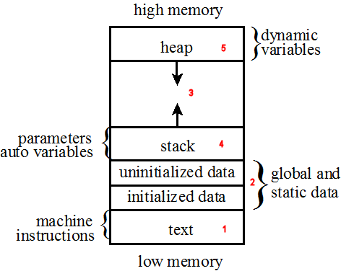
Where are Static Variables Stored?
https://icarus.cs.weber.edu/~dab/cs1410/textbook/4.Pointers/images/layout.png
Dynamic variables are stored in the heap (malloc, calloc)
Stack is where parameters, local vars, and call records are
Uninitialized & initialized are where static and global variables are stored
As we can see, this will not change so we ideally want minimal (if any) global and static data
If you need a global variable, rethink your approach – there is possibly a better way

Slide 4
When Should I use a Static variable?
When we need to
Maintain a variable among multiple instances of a class (C++)
Maintain a value from function call to function call (i.e., strtok)

Slide 5
Pros & Cons
Pros
Allows us to maintain a value in between function calls
Allows us to maintain a count of instances of a specific class
Cons
Becomes non-thread safe
We either need to write a new function or use locks
Uses memory even if we do not touch the function or class (stored in BSS or DATA)
Non-static will grow/shrink based on the usage of functions and classes
Can become more difficult to debug when there are many static vars

Slide 6
Resources to look at for further detail
https://en.wikipedia.org/wiki/Data_segment
https://en.wikipedia.org/wiki/.bss
https://www.gnu.org/software/c-intro-and-ref/manual/html_node/Static-Functions.html

Slide 7
Strtok
#include <string.h> (C)
#include <cstring> (C++)

Slide 8
How to Call strtok
char * input = ”everything is a string”;
char * token;
token = strtok(input, “ “);
printf(“%s\n”, token);
while ((token = strtok(NULL, “ “)) != NULL) {
printf(“%s\n”, token);
}

Slide 9
How to Call strtok (Commented)
char * input = ”everything is a string”; // input
char * token; // where we will store the token
token = strtok(input, “ “); // start strtok (static pointer in strtok is set to input)
printf(“%s\n”, token); // process token
while ((token = strtok(NULL, “ “)) != NULL) { // set to the next token, and run if non-null
printf(“%s\n”, token); // process token
}

Slide 10
Struct keyword
Look at https://github.com/swiftlydesigner/121-Practice-Review/blob/main/Labs/Fall%20'23/Lab-11/Lab%2011.pdf
121-Practice-Review > Labs > Fa ‘23 > Lab-11

Slide 11
Malloc
#include <stdlib.h>

Slide 12
How to call
int * randomNumbers = (int *)malloc(sizeof(int) * 100);
if (!randomNumbers) {
// handle error and stop execution. (not allocated)
}
memset(randomNumbers, 0, sizeof(int) * 100);
// populate with rand nums
// use as needed
free(randomNumbers);

Slide 13
HOW TO CALL (ENGLISH DESCRIPTION)
Assign a variable to the call to malloc, casting to the pointer type (i.e., int*)
If we want to allocate a node, then the size will be `sizeof(NAME_OF_STRUCT)`
Check if it was allocated!
Use memset to zero out all numbers or a for loop to set a default value
We do this to insure we do not read garbage values
If you are going to write data to all addresses, 3 can be skipped
Process it as you would any other variable
Once you no longer need the allocation, call free
Malloc and free are likely to be in different functions
Still, they must have a 1:1 call ratio

Slide 14
functions
malloc ptr = malloc(SIZE_OF_TYPE * NUM_OF_ELES);
Use when we want to allocate anything (although calloc is sometimes preferred)
calloc ptr = calloc(NUMBER_OF_ELES, SIZE_OF_TYPE);
Use when we have an array to allocate. Format is easy to understand
realloc oldPtr = realloc(oldPtr, NEW_SIZE);
Use when we need to resize a previous allocation
free free(ptr);
Must be called once for every time malloc is called.
Any allocated memory must be freed.
If it is not freed, it is called a memory leak. Inaccessable allocated memory

